Slide 1
WOOSUNG VALVE CO., LTD
COMPANY
PROFILE
REV.2019-A

Slide 2
VISION
“ To expand our position as the world leader
in the design, Manufacture , sales and service of Check Valve “

Slide 3
Topics
Qualification
Products
Equipment
General Information
Supply Record

Slide 4
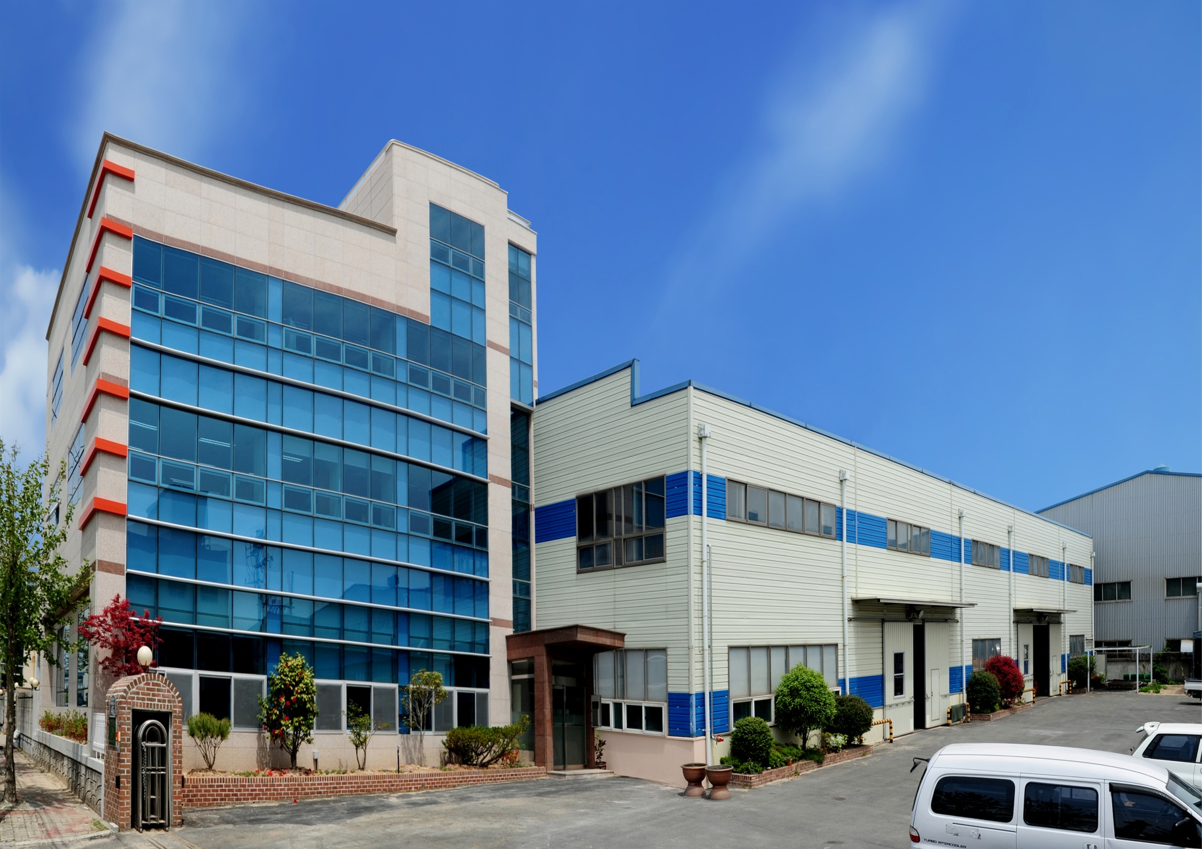
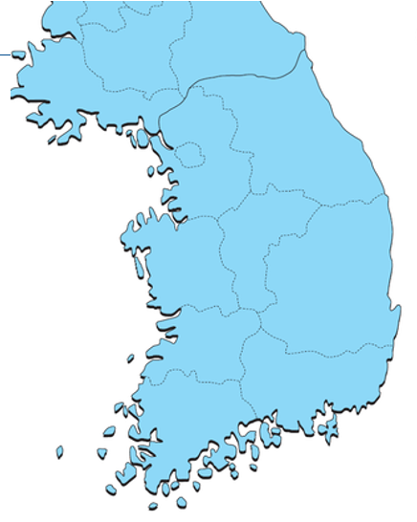
Company Overview & Location
NAME | WOOSUNG VALVE CO.,LTD.
TEL. | 82-51-831-1251
FAX. | 82-51-831-1201
WEBSITE | www.pancheck.co.kr
E-MAIL | wsv@pancheck.co.kr
Seoul Office
SEOUL
Rep. of Korea
Head Office
& Plant
BUSAN

Slide 5
History
9 Renewal of CE
2011. 11 Renewal ISO 9001:2008
12 Certified as INNO-BIZ (Technical Innovation Company)
1 Obtained Safety Certificate for Safety Valve from KOSHA
11 Extended of factory
2012. 11 Obtained the certificate of KC (Sanitation Safety Standard) by
from Korea Water & Wastewater Works Association
2012. 12 Certified as Busan Leading Company by Busan City
2 Possessing of Intellectual Property Light
(Patent 4, Trade Mark Registration 1, Design Registration 1,
Utility Model Registration 2, Design Right 2)
3 Obtained the certificate of API6D
2015. 3 Obtained the certificate of FIRE SAFETY CERTIICATES
2015. 6 Obtained the certificates of registration for NIGC
2015. 7 Patent on a Swing Check Valve ( No. 10-1535345 )
2016. 11 Vendor Registration
Petronas /Malaysia, ICOFC /IRAN, NPC /IRAN ADNOC/ U.A.E
2017. 9 Siemens Approved Distribution Paterner
1980's
2000's
1981 Established a company
1990's
1990 Started Pan Check Valve production
2004.10 Moved to Noksan Industrial Complex, Busan
. 2 Registration of trade mark (Reg. No. 04-0663823) of
PANCHECK
10 Incorporated, WOOSUNG VALVE CO,. LTD.
3 Obtained CE mark ( No. CE-PED-H-WSV 001 08-KOR)
1 Obtained Certificate of Reliability : Ministry of Knowledge
Economy
3 A patent (Patent No. 10-0890778) on Assembled type
Check Valve
2009. 9 Obtained ISO9001:2008
8 Obtained Safety Certificate from KOSA for Safety Valve
4 Patent (Patent No. 10-1031803) on a Check Valve
7 Established a Development Institute and obtained the certificate
2000's

Slide 6
Growth Procedure of Company
Start up
Growth of Business
Expansion of Business
Moved to Noksan Industrial Complex,
Busan (2004. 10)
Registration of trade mark (2006. 2)
Incorporated, WOOSUNG VALVE
CO,. LTD. (2006. 10)
Establishment on
company
(1981.4)
Start of production of
PAN Check Valve
(1992. 3)
CE Certificate(2008..3)
ISO 9001 Certificate (2009.9)
API6D Certificate (2015.04)
Establish of R&D Center
Start the supplying to EPC, Power Plant, Shipyard, General Plant, Pump, Airport and etc.

Slide 7
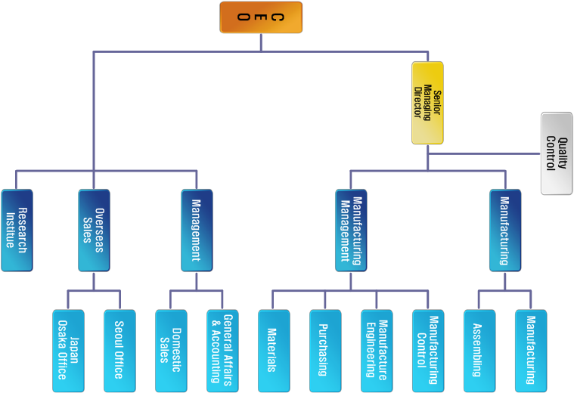
Organization

Slide 8
Topics
Qualification
Products
Equipment
General Information
Supply Record

Slide 9
Order Intake & Sales
USD 10.7 M

Slide 10
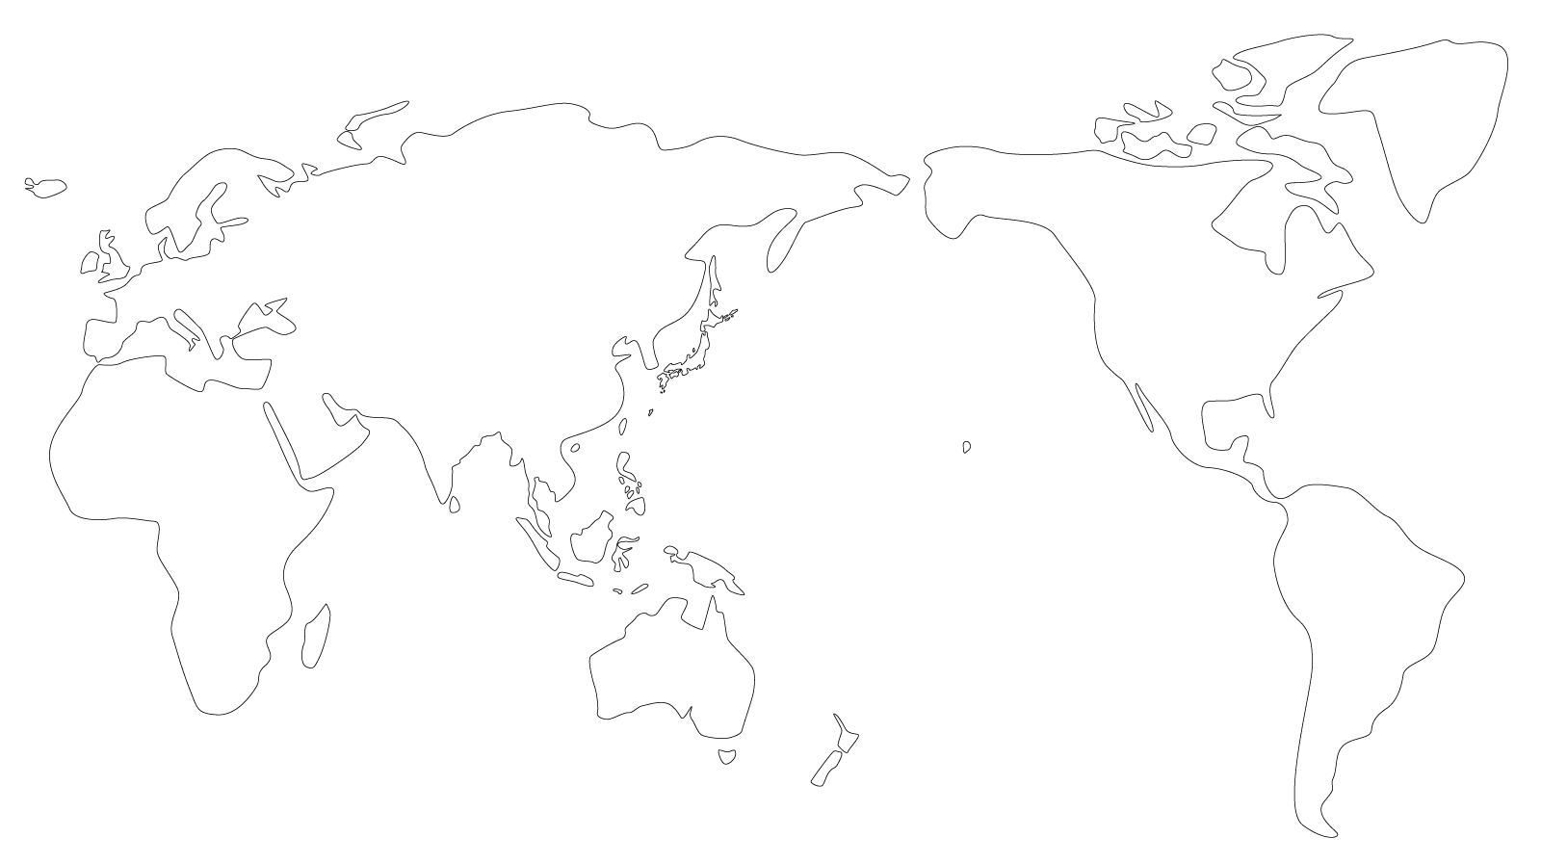
WOOSUNG Orders from World Regions
Booking in FY16~19
Europe
$ 0.23M
(13.5%)
WSV
Americas
Country | Company
U.S.A. | DEKKER VACUUM
ECUADOR | SERPRODIN S.A
CHINA | CHANGZHOU
INDIA | EVEREST
JAPAN | KUNO
 | SANWA
 | MYAKI
SINGAPORE | SENG CHOON
AUSTRALIA | WINNELLIE HYDRAILICS
HONGKONG | CHI FUNG
MALAYSIA | ALIOGAZ KUKUH SDN BHD
Middle East
$ 0.16M
(9.4%)
$ 0.01M
(1.0%)
Asia
$ 1.28M
(74.9%)
Pacific
Market | Coverage
Asia | 74.9%
Europe | 13.5%
Americas | 9.4%
Pacific | 1.2%
Middle East | 1.0%
$ 0.01M
(1.2%)

Slide 11
Available Material & Capacity
Casting Materials | Carbon Steel (WCB, WCC, LCB, LCC) Stainless Steel (CF8, CF8M, CF3, CF3M) Duplex S.S (UNS J92205(4A), J93371(3A)) Super Duplex S.S (UNS J93404(5A), J93380(6A)) Alloy Steel (WC6, WC9, C5, C12) Nickel Alloy (CU5MCuC (Inconel)) (Ni) Al Bronze Ductile Iron
Production Capacity | Check Valves : Approx.200,000 EA / year 150 Ton Casting Capacity / year

Slide 12
Major Supply Record
No. | Year | Customer | End User or Project | Supplies | Q`ty | Service Area | Country
1 | Since 2009 | Samsung Techwin | Samsung Techwin | Dual check & Pan check valve 25A(1")~300A(24") SS304 | Over 300 PCS /Month | Turbo Compressor | WORLDWIDE
2 | Since 1997 | Wilo Pump | Wilo Pump | Pan check valve 25A(1")~300A(12") SS304 | Over 500 / Month | PUMP | WORLDWIDE
3 | 2018. 12 | DOOSAN HEAVY INDUSTRIES CO. (PK) | GOSUNG TERMAL POWER PLANT | DUAL CHECK 4" ~12" 150LB WCB | 28EA | POWER PLANT | KOREA
4 | 2018. 12 | DOOSAN HEAVY INDUSTRIES CO. / KC COTTRELL | SHINSEOCHEON PROJECT (KOMIPO) | SWING PAN CHECK 24" 150LB | 4EA | POWER PLANT | KOREA
5 | 2018. 12 | HYUNDAI ENGINEERING | MELAKA PROJECT | DUAL CHECK 3" ~8" 150LB WCB, A536 + RUBBER LINING | 18EA | REFINERY | MALAYSIA
6 | 2018. 12 | LOTTE E&C | LMAA 3 PROJECT | DUAL CHECK 3, 4" 150LB | 28EA | CHEMICAL | KOREA
7 | 2018. 03 | DOOSAN HEAVY INDUSTRIES CO. (PK) | SHINSEOCHEON PROJECT (KOMIPO) | DUAL CHECK 6" ~ 24" 150LB WCB | 16EA | POWER PLANT | KOREA
8 | 2017. 07 | DOOSAN HEAVY INDUSTRIES CO. | SHONGHAU PH2 PROJECT | DUAL CHECK 150LB 3" ~ 24" | 12 | POWER PLANT | VIETNAM
9 | 2017. 07 | DOOSAN HEAVY INDUSTRIES CO. | FADHILI PROJECT | DUAL CHECK 150LB 3" ~ 6" CF3M | 36 | POWER PLANT | UAE
10 | 2017. 06 | HYOSUNG | PP3 PJT | DUAL CHECK 600LB 2"~8" WCB | 64 | Petrochemical | KOREA
11 | 2017. 06 | SK AIR GAS | M15 PH1 PROJECT | DUAL CHECK 10K 200A ~ 500A CF8 PTFE | 35 | GAS | KOREA
12 | 2017. 05 | DOOSAN HEAVY INDUSTRIES CO. | SHONGHAU PH1 PROJECT | DUAL CHECK 150LB 3" ~ 24" | 12 | POWER PLANT | VIETNAM
13 | 2018.12 | DAELIM INDUSTRIAL CO. | OMSK REFINERY PROJECT | NONSLAM NOZZLE CHECK 2" ~14" PN40 | 10EA | REFINERY | RUSSIA
14 | 2018.05 | DAELIM INDUSTRIAL CO. | OMSK REFINERY PROJECT | NONSLAM NOZZLE CHECK 2" ~ 6" PN40~ 1500LB | 2EA | REFINERY | RUSSIA
15 | 2018.01 | PETRONAS / CARMIN | DULANG B PIPING UPGRADE D,E, F PKG | SWING CHECK 10", 12" 900LB A890-4A | 2EA | OIL & GAS | MALAYSIA

Slide 13
Major Supply Record
No. | Year | Customer | End User or Project | Supplies | Q`ty | Service Area | Country
16 | 2017.08 | GUNJANG ENERGY | GE4 | NOZZLE CHECK JIS 20K 200A SCPH2 | 18 | POWER PLANT | KOREA
17 | 2017.07 | SK AIR GAS | SK HYNIX M14-2A PROJECT | DUAL CHECK 20K 350A SCS13 | 20 | GAS | KOREA
18 | 2016.07 | HYOSUNG | PP3 PJT | DUAL CHECK 150LB~600LB 3"~ 16" | 167 | Petrochemical | KOREA
19 | 2016.06 | Samsung Engineering | ASAN TANGJUNG | NOZZLE CHECK 20K 500A CF8 | 12 | SEMICONDUCTOR | KOREA
20 | 2016.05 | Samsung Engineering | K PROJECT ( ASAN TANGJUNG) | DUAL CHECK 10K 300A SCPH2 | 18 | Semiconductor | KOREA
21 | 2015.12 | DOOSAN HEAVY INDUSTRIES CO. | KOREA MIDLAND POWER CO., LTD. (KOMIPO) - SEOUL COMBINED | DUAL CHECK 150LB 6"~8" | 30 | Power Plant | KOREA
22 | 2015.12 | DOOSAN HEAVY INDUSTRIES CO. | HWASUNG DONGTAN POWER PLANT | DUAL CHECK 150LB 6"~8" | 30 | Power Plant | KOREA
23 | 2015.12 | HYUNDAI STEEL | HYUNDAI STEEL / SEOSAN | NOZZLE CHECK JIS 10K/ 16K 100A / 150A / 200A/ 250A / 300A SCPH2 | 18 | STEEL | KOREA
24 | 2015.10 | DOOSAN HEAVY INDUSTRIES CO. | VT4 THERMAL POWER PLANT | DUAL CHECK 150LB 2" ~12" | 52 | Power Plant | VIETNAM
25 | 2015.04 | HYUNDAI STEEL | C3 SCARFING PROJECT | DUAL CHECK JIS 10K 80A ~600A FC200/ SCS13 | 47 | WATER TREATMENT | KOREA
26 | 2015.04 | HYUNDAI STEEL | COD / COG GAS | DUAL CHECK 150LB ~600LB 4" ~28" WCB | 51 | HYDROGEN GAS | KOREA
27 | 2015.03 | POSCO E&C | KWANGYANG 7 GL NEW PROJECT | DUAL CHECK JIS 10K 80A ~700A FC200/ SCS13 | 31 | ENERGY PLANT | KOREA
28 | 2014.12 | DOOSAN HEAVY INDUSTRIES CO. | SOUTH HELWAN PROJECT | DUAL CHECK 150LB 6" CF8 | 12 | POWER PLANT | EGYPT
29 | 2014.11 | POSCO E&C | POSCO KWANGYANG -YEONJU #1~#2 | DUAL CHECK JIS 20K 4" ~8" CF8 | 48 | STEEL | KOREA
30 | 2014.11 | DOOSAN HEAVY INDUSTRIES CO. | SHIN BORYEONG HEAT POWER PLANT #1, 2 | DUAL CHECK 3"~ 12" ANSI 150LB CF8 | 20 | POWER PLANT | KOREA

Slide 14
Major Supply Record
No. | Year | Customer | End User or Project | Supplies | Q`ty | Service Area | Country
31 | 2014.10 | DOOSAN HEAVY INDUSTRIES CO. | LUBE OIL YEOSU #1 STG PROJECT | DUAL CHECK 300LB 3" WCB | 32 | POWER PLANT | KOREA
32 | 2014.09 | DOOSAN HEAVY INDUSTRIES CO. | BARAKA PROJECT | SWING PAN CHECK 150LB 3" CF3M | 42 | POWER PLANT | UAE
33 | 2014.08 | DOOSAN HEAVY INDUSTRIES CO. | MA' ADEN AMONIA PHOSTATE | SWING PAN CHECK 150LB 3" - CLEANING | 48 | CHEMICAL | SAUDI ARABIA
34 | 2014.06 | STX Heavy Industrial Co. | Iraq MOE Project | Pan Check JIS 10K 50A | 55 | POWER PLANT | IRAQ
35 | 2014.06 | DOOSAN HEAVY INDUSTRIES CO. | SinBoryeong Heat Power Plant #1, 2 | Swing Pan Check 150# 3" ~10" | 36 | POWER PLANT | KOREA
36 | 2014.04 | STX Heavy Inderstrial Co. | Samcheok Green Power Denitrification System #1, 2 | PAN CHECK 150# 3" ~14" | 13 | POWER PLANT | KOREA
37 | 2014.02 | Samsung Techwin | India IREP Project | Dual Check 150LB 2" SS304 | 12 | OIL & GAS | INDIA
38 | 2014.01 | SK E&C | GUNJANG ENERGY 3 PROJECT | Swing Pan check valve ANSI 150# 3"~8" SS304 | 12 | POWER PLANT | KOREA
39 | 2013.09 | DOOSAN HEAVY INDUSTRIES CO. | Kudgi # 3 Power Plant | Swing Pan check valve 250A(10") SS304 | 27 | POWER PLANT | INDIA
40 | 2013.08 | POSCO E&C | Gwangyang Donghoan Desalination Plant Project | Dual Check valve JIS 10K 50A, 250A, 300A, JIS 20K 250A | 15 | Water treatment | KOREA
41 | 2013.08 | DOOSAN HEAVY INDUSTRIES CO. | Saudi Electricity Co. Babigh Power Plant NO2 | Pan check valve ANSI 150 80A(1")~400A(8") SS304 | 33 | Power Plant | SAUDI ARABIA
42 | 2013.05 | Hanwha E&C | Orange Project (Polysilicon) | Oil free Pan check valve 15A(1/2")~25A(1") ANSI 150 Material SS304, 316L | 392 | CHEMICAL | KOREA
43 | 2013.02 | DOOSAN HEAVY INDUSTRIES CO. | Saudi Electricity Co. Babigh Power Plant NO2 | Pan check valve ANSI 150 25A(1")~200A(8") SS304 | 130 | POWER PLANT | SAUDI ARABIA
44 | 2012.09 | Samsung Techwin | Aramco Shyba Project | Dual Check 150LB 40A(1 1/2"), 50A(2") Material SS304 | 51 | Petrochemical | SAUDI ARABIA
45 | 2012.08 | STX Heavy Industrial Co. | Iraq MOE Diesel Plant | Pan check valve JIS10K 80A Material WCB | 70 | Power Plant | IRAQ

Slide 15
Major Clients - Korea
EPC
Power Plant
Shipyard
General Plant
Pump
Airport

Slide 16
Major Clients - Overseas

Slide 17
Topics
Products
Equipment
General Information
Supply Record
Qualification

Slide 18
Quality Management Policy
Slogan
Customers are hard to be satisfied but their requests are always right
Target of Quality Control
Customers dissatisfaction rate is less 0.03%
Inspection of all products
Policy of Quality Control
Form the fundamental
Customer’s dissatisfaction feedback
Products record management
Active A/Service and continuous service
Trouble rate 0.03%

Slide 19
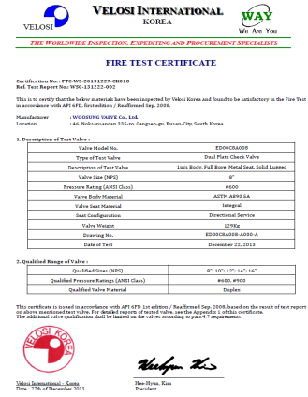
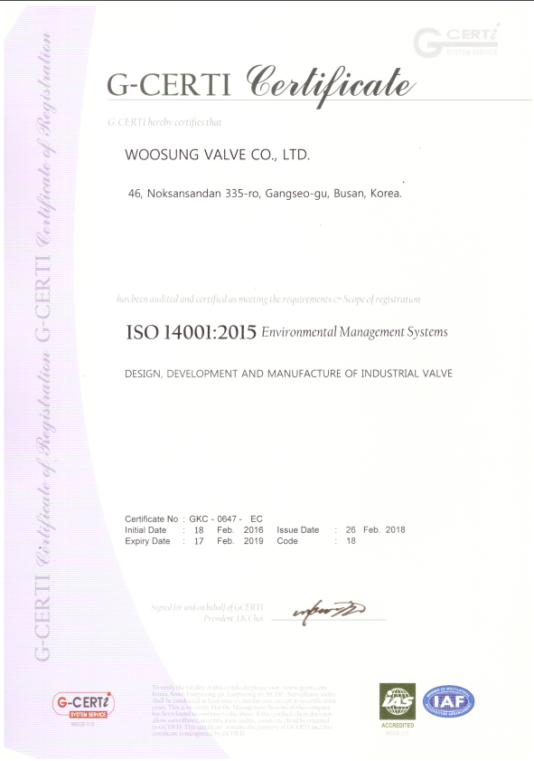
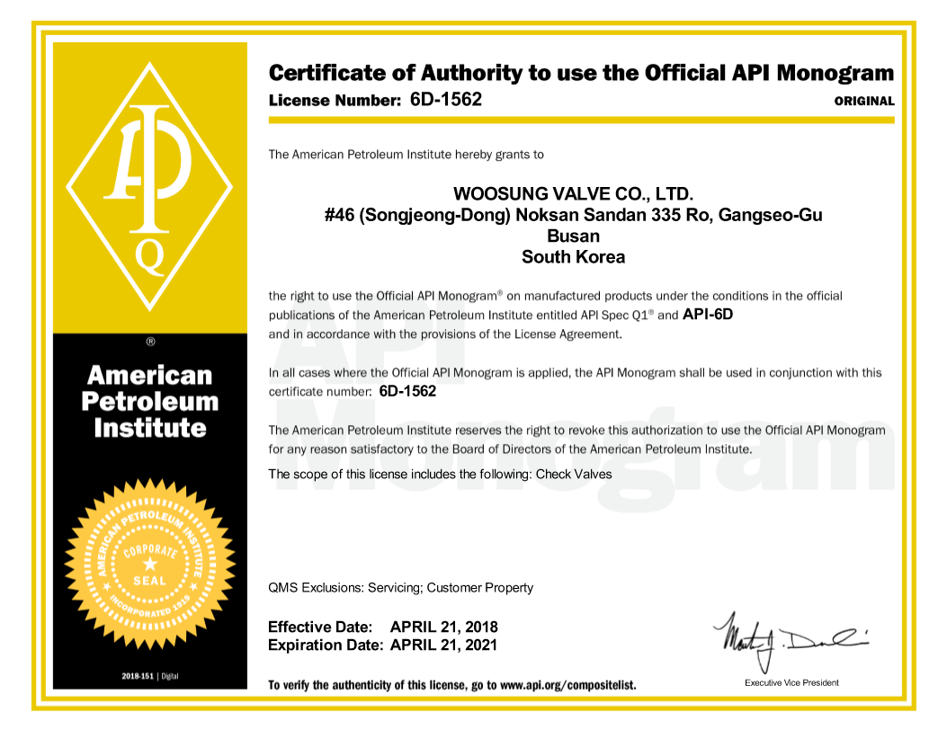
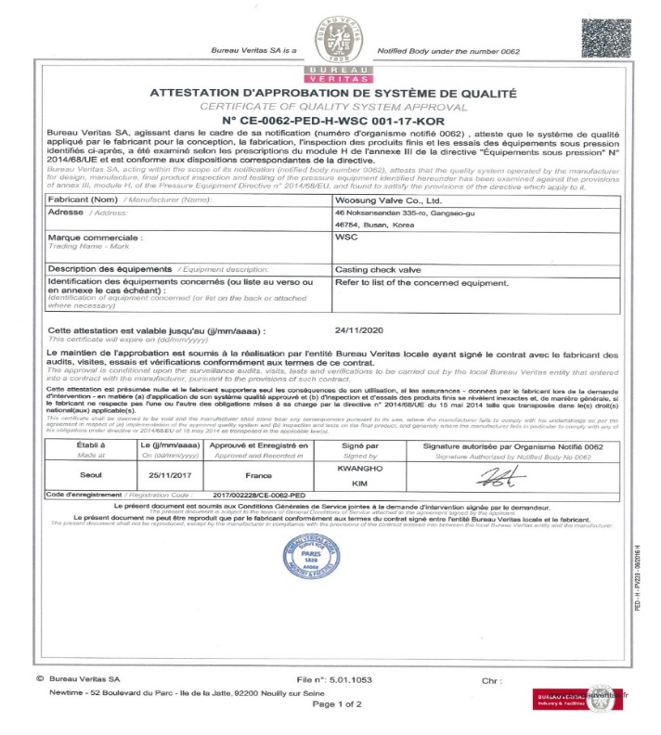
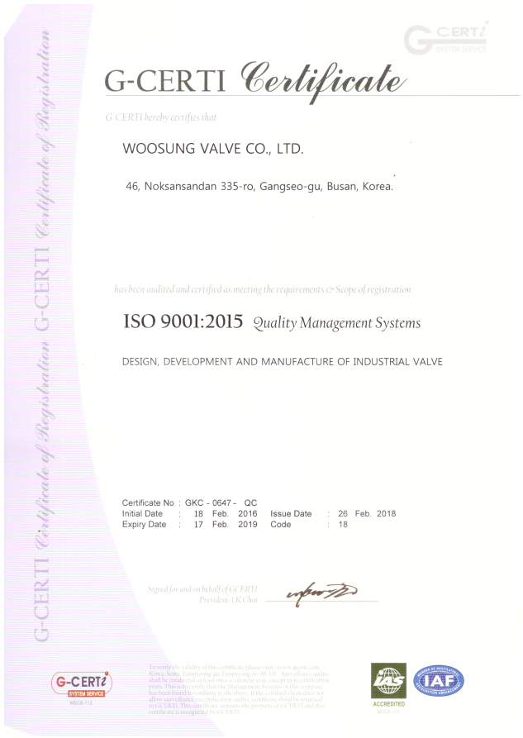
Certificate
Fire Safety Certificate
ISO 14001 Certificate
API 6D Certificate
ISO 9001 Certificate
BV Certificate

Slide 20
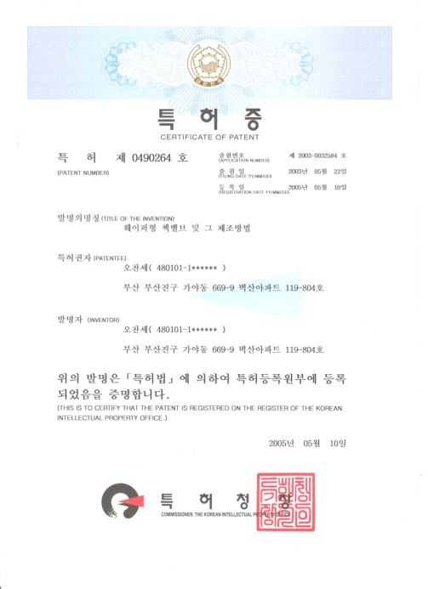
Certificate _ Korea Patent & Trade Mark
Certificate of Patent
Certificate of Trademark
Patent on a new device

Slide 21
Topics
Equipment
General Information
Supply Record
Qualification
Products

Slide 22
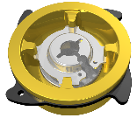
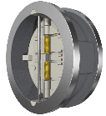
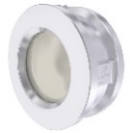
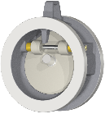
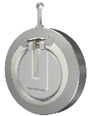
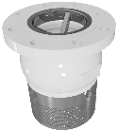
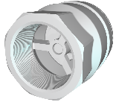
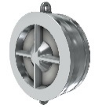
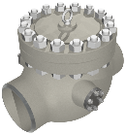
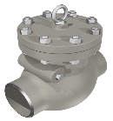
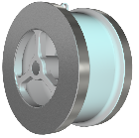
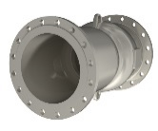
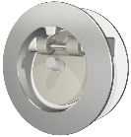
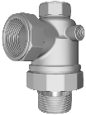
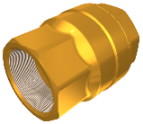
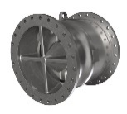
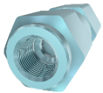
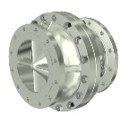
Products List
Non-Slam Nozzle Check
CNZ
PCN
Tilting Check
TLP/TLC
TLB
SNF
DNF
WNF
LTP
Swing Check
SP/SPS
SWB/SWF
Other Valve
Foot
Valve
Pan Check
PC/PA
PCS/PAS
ANA
CV/UCV
BU
Dual Plate Check
DD
Safety Valve
5-Way Check
DDB
DDL
DDF

Slide 23
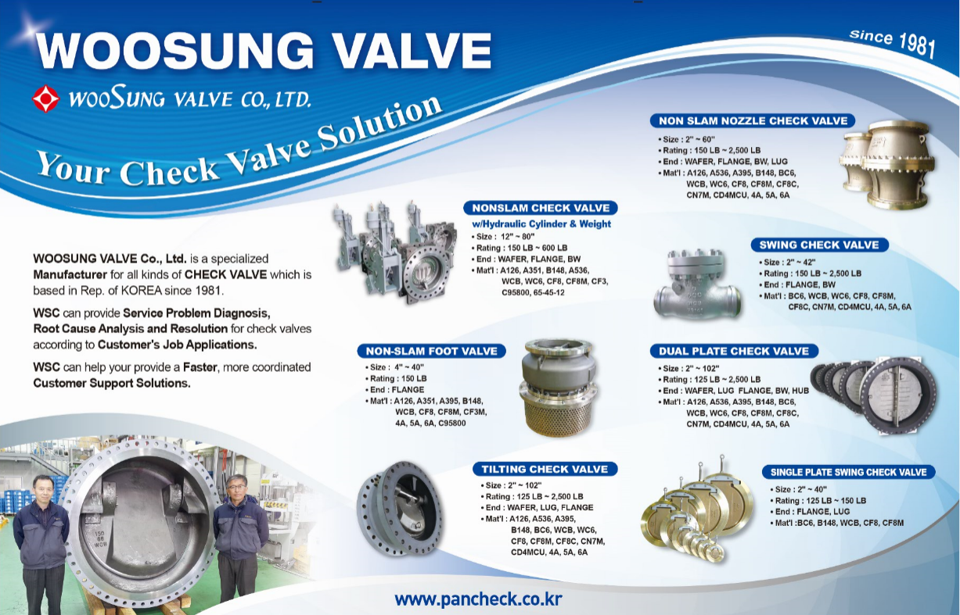
Products

Slide 24
Topics
General Information
Supply Record
Qualification
Products
Equipment

Slide 25
Equipment & Measuring Tools
MCT
Maker – Doosan
Installed Year – 2019
CNC Turing Center
Maker – Doosan
LATHE
Maker - Namseon
Installed Year – 2008
Q`ty – 2EA
Installed Year – 2007
Q`ty – 1EA
Q`ty – 2EA
Milling Machine
Maker - Hwacheon
Installed Year – 2012
Q`ty – 1EA
Radial Ball Machine
Maker - Changjo
Installed Year – 2007
Q`ty – 2EA
UP Drilling
Maker – Jokwang
Installed Year – 2009
Lapping
Maker – Cleantech
Polishing
Maker - Kumyeong
Installed Year – 2003
Q`ty – 3EA
Installed Year – 2008
Q`ty – 2EA
Q`ty – 1EA
Tig & ARC & Spot Welder
Maker - Woojin & Jinseong
Installed Year – 2000 & 2005
Q`ty – 3EA
Screw Compressor
Maker - KAESER
Installed Year – 2010
Q`ty – 2EA

Slide 26
Equipment & Measuring Tools
500 Ton Hydraulic Pressure
Maker – Cleantech
Installed Year – 2013
80 Ton Hydraulic Pressure
20 Ton Hydraulic Pressure
Maker - Howon
Installed Year – 1999
Q`ty – 1EA
Q`ty – 1EA
Air Pressure Tester
Maker - Piatech
Installed Year – 2014
Q`ty – 1EA
Valve Tester
Maker - Intech
Installed Year – 2003
Q`ty – 1EA
Q`ty – 1EA
Installed Year – 2006
Maker – Cleantech
Safety Valve Tester
Maker – Deaha
Installed Year – 2013
Cryogenic Tester
Maker – Deaha
Sand blasting
Maker - World
Installed Year – 2018
Q`ty – 3EA
Installed Year – 2018
Q`ty – 2EA
Q`ty – 1EA
Ultrasonic wave cleaner
Maker - Shinha
Installed Year – 2003
Q`ty – 1EA
3-Way Valve Tester
Maker - Cleantech
Installed Year – 2007
Q`ty – 1EA

Slide 27
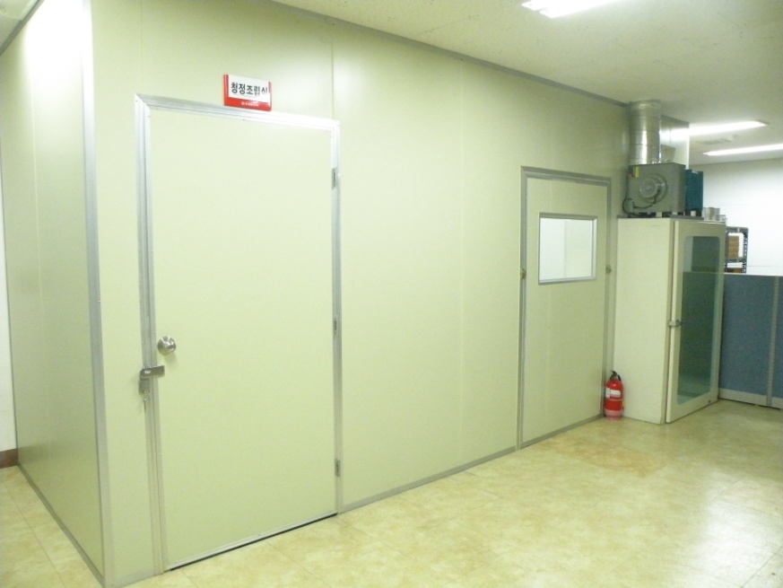
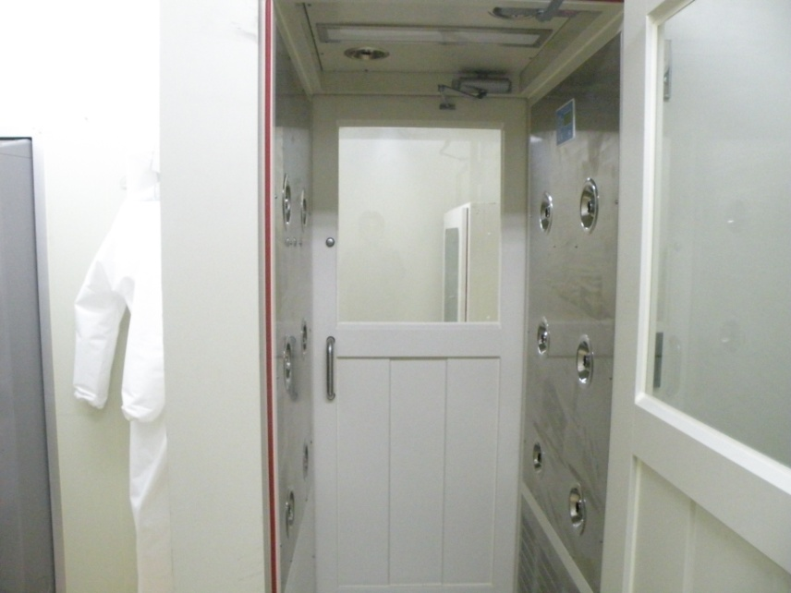
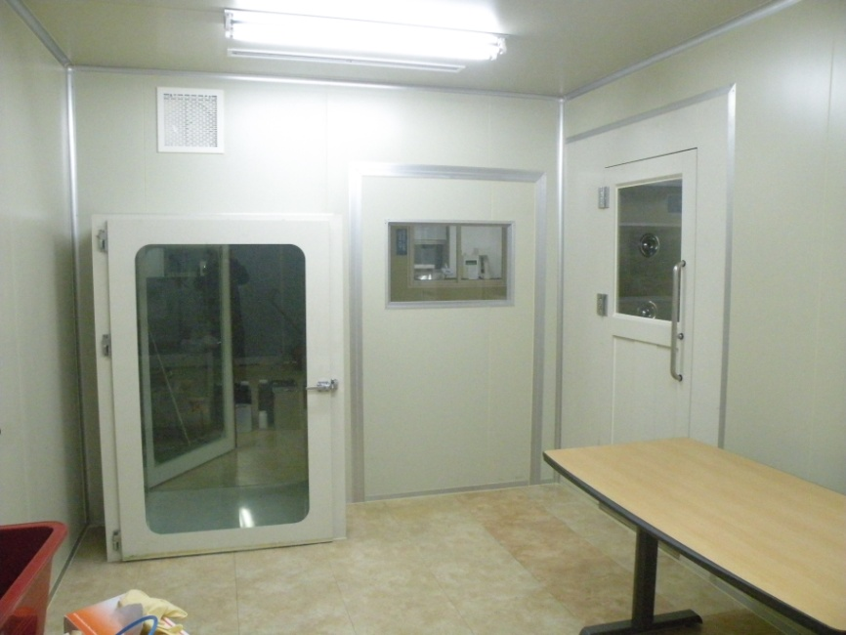
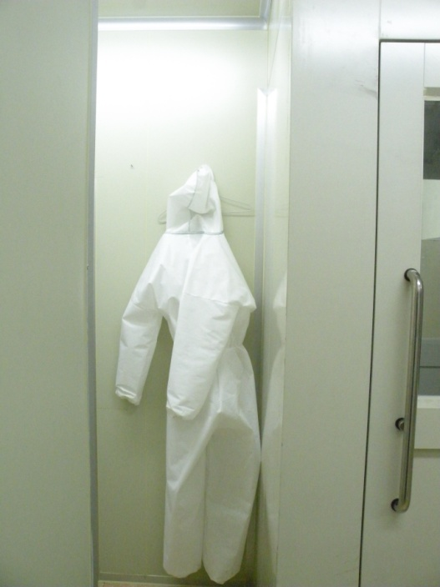
Clean Room

Slide 28
Questions
THANK YOU
ALWAYS BE WITH YOU

