Slide 1
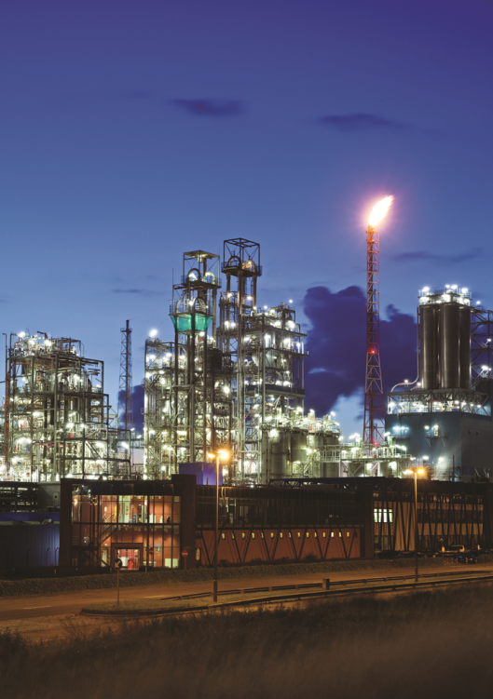

WOOSUNG VALVE CO., LTD
우성밸브
회사소개서
REV.2019-A

Slide 2

VISION
“ 우리는 Check Valve분야에서 생산, 디자인, 서비스, 매출에서 Leader로서 우리의 위치를 확대시키는 것입니다. “

Slide 3
목 차
품질
제품
장비
회사 소개
납품 실적

Slide 4
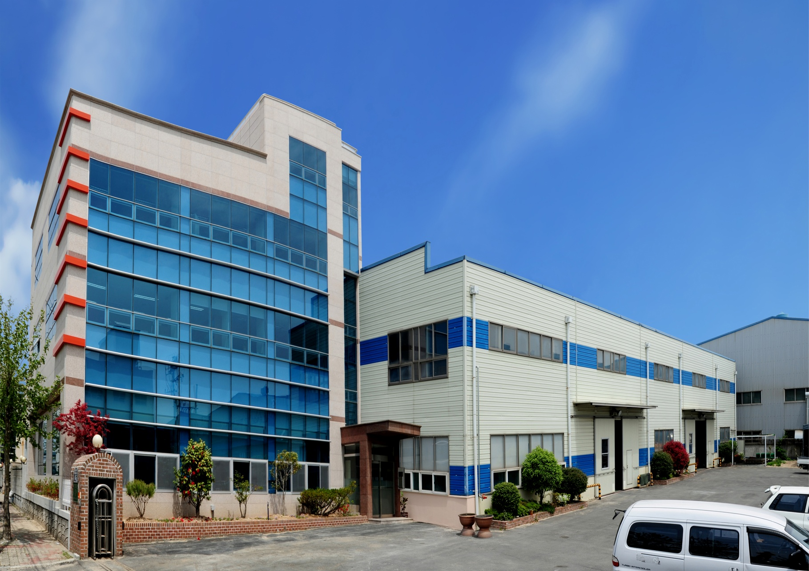
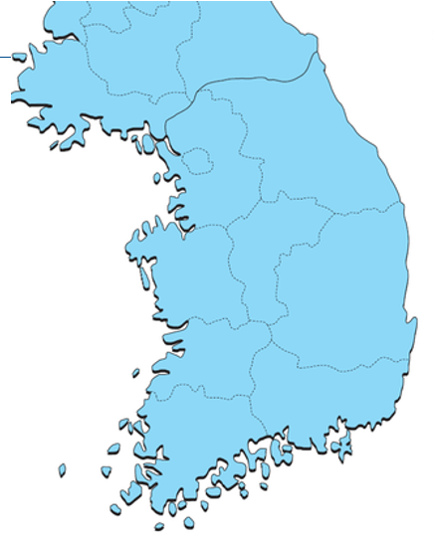
회사 전경 및 위치
NAME | WOOSUNG VALVE CO.,LTD.
TEL. | 82-51-831-1251
FAX. | 82-51-831-1201
WEBSITE | www.pancheck.co.kr
E-MAIL | wsv@pancheck.co.kr
SEOUL
서울사무소
Rep. of Korea
본사 & 공장
BUSAN

Slide 5

History
1980's
2012 2 특허등록 (특허 제 10-1124532호) : 쿠션 체크밸브
2012. 11 위생안전기준 인증 (한국상하수도 협회)
공장 증축 (2층, 735.2m²)
2012. 12 선도기업 지정 (부산-2019 갱신)
6 수도용 적합인증서 (한국상하수도협회
2014. 11 기술혁신형 중소기업 INNO-BIZ (중소기업청- 2017년 갱신)
2015. 1 강소기업 (고용노동부)
3 FIRE SAFETY CERT 인증
2015. 4 API 6D CERT 인증 (2018 갱신)
6 NIGC 업체 등록
2015. 7 특허등록 (특허 제 10-1535345호) : 스윙 체크밸브
2016. 11 밴더등록
Petronas /Malaysia, ICOFC /IRAN, NPC /IRAN ADNOC/ U.A.E
9 SIEMENS Approved Distribution Partner 지정
2018. 6 소재 부품 전문기업 지정 (산업통상자원부)
2018.4 API 6D 갱신
2019.1 ISO9001 & ISO14001 갱신
1981 회사 설립
2000's
1990's
1990 판 체크밸브 생산 시작 (PC, PA Type)
2004.10 부산 녹산산업단지 공장 이전
. 2 상표등록 (Reg. No. 04-0663823) : PANCHECK
10 법인 전환.
3 CE 인증 (No. CE-PED-H-WSV 001 08-KOR)
1 부품 소재 신뢰성 인증 : 지식경제부 기술 표준원
3 특허 등록 (No. 10-0890778) : 조립식 체크 밸브
2009. 9 ISO9001:2008 취득
8 안전인증서 획득 : 안전밸브 (한국산업안전공단)
4 특허 등록 (No. 10-1031803)
7 기업부설연구소 설립 (한국산업기술진흥협회 인정)
2011. 9 CE 인증 갱신
2011.11 ISO 9001:2008 갱신
2011.12 INNO-BIZ (Technical Innovation Company) 인증
2000's

Slide 6

회사 발전
초창기
성장기
사업 확대
부산 녹산산업단지 이전(2004. 10)
Trade mark등록 (2006. 2)
우성밸브 법인 전환(2006. 10)
회사 설립
(1981.4)
PAN Check Valve 생산시작
(1992. 3)
CE Certificate(2008..3)
ISO 9001 Certificate (2009.9)
API6D Certificate (2015.04)
R&D Center 설립
EPC, Power Plant, Shipyard, General Plant, Pump, Airport에 공급

Slide 7






조직도
대표이사
영업부
연구소
생산부
구매
품질
관리
자재관리

Slide 8
Topics
품질
제품
장비
회사 소개
납품 실적

Slide 9
수주 & 매출
107억

Slide 10
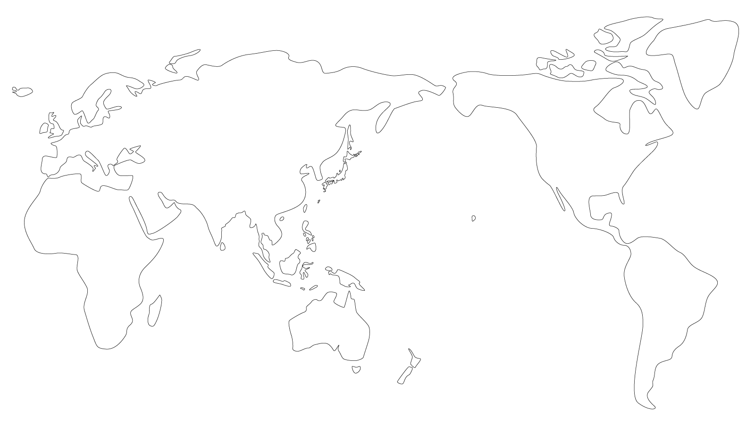
우성밸브 해외 매출 현황
Europe
$ 0.23M
(13.5%)
WSV
Americas
Country | Company
U.S.A. | DEKKER VACUUM
ECUADOR | SERPRODIN S.A
CHINA | CHANGZHOU
INDIA | EVEREST
JAPAN | KUNO
 | SANWA
 | MYAKI
SINGAPORE | SENG CHOON
AUSTRALIA | WINNELLIE HYDRAILICS
HONGKONG | CHI FUNG
MALAYSIA | ALIOGAZ KUKUH SDN BHD
Middle East
$ 0.16M
(9.4%)
$ 0.01M
(1.0%)
Asia
$ 1.28M
(74.9%)
Pacific
Market | Coverage
Asia | 74.9%
Europe | 13.5%
Americas | 9.4%
Pacific | 1.2%
Middle East | 1.0%
$ 0.01M
(1.2%)

Slide 11
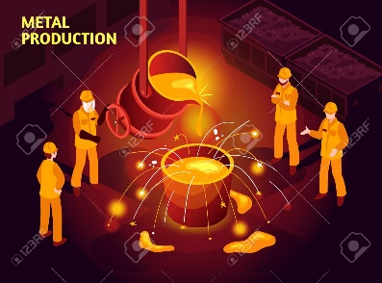

공급 가능 Material & 생산 능력
Casting Materials | Carbon Steel (WCB, WCC, LCB, LCC) Stainless Steel (CF8, CF8M, CF3, CF3M) Duplex S.S (UNS J92205(4A), J93371(3A)) Super Duplex S.S (UNS J93404(5A), J93380(6A)) Alloy Steel (WC6, WC9, C5, C12) Nickel Alloy (CU5MCuC (Inconel)) (Ni) Al Bronze Ductile Iron
Production Capacity | Check Valves : Approx.200,000 EA / year 150 Ton Casting Capacity / year Size : 1/4” ~ 80”

Slide 12
주요 공급 실적
No. | Year | Customer | End User or Project | Supplies | Q`ty | Service Area | Country
1 | Since 2009 | Samsung Techwin | Samsung Techwin | Dual check & Pan check valve 25A(1")~300A(24") SS304 | Over 300 PCS /Month | Turbo Compressor | WORLDWIDE
2 | Since 1997 | Wilo Pump | Wilo Pump | Pan check valve 25A(1")~300A(12") SS304 | Over 500 / Month | PUMP | WORLDWIDE
3 | 2018. 12 | DOOSAN HEAVY INDUSTRIES CO. (PK) | GOSUNG TERMAL POWER PLANT | DUAL CHECK 4" ~12" 150LB WCB | 28EA | POWER PLANT | KOREA
4 | 2018. 12 | DOOSAN HEAVY INDUSTRIES CO. / KC COTTRELL | SHINSEOCHEON PROJECT (KOMIPO) | SWING PAN CHECK 24" 150LB | 4EA | POWER PLANT | KOREA
5 | 2018. 12 | HYUNDAI ENGINEERING | MELAKA PROJECT | DUAL CHECK 3" ~8" 150LB WCB, A536 + RUBBER LINING | 18EA | REFINERY | MALAYSIA
6 | 2018. 12 | LOTTE E&C | LMAA 3 PROJECT | DUAL CHECK 3, 4" 150LB | 28EA | CHEMICAL | KOREA
7 | 2018. 03 | DOOSAN HEAVY INDUSTRIES CO. (PK) | SHINSEOCHEON PROJECT (KOMIPO) | DUAL CHECK 6" ~ 24" 150LB WCB | 16EA | POWER PLANT | KOREA
8 | 2017. 07 | DOOSAN HEAVY INDUSTRIES CO. | SHONGHAU PH2 PROJECT | DUAL CHECK 150LB 3" ~ 24" | 12 | POWER PLANT | VIETNAM
9 | 2017. 07 | DOOSAN HEAVY INDUSTRIES CO. | FADHILI PROJECT | DUAL CHECK 150LB 3" ~ 6" CF3M | 36 | POWER PLANT | UAE
10 | 2017. 06 | HYOSUNG | PP3 PJT | DUAL CHECK 600LB 2"~8" WCB | 64 | Petrochemical | KOREA
11 | 2017. 06 | SK AIR GAS | M15 PH1 PROJECT | DUAL CHECK 10K 200A ~ 500A CF8 PTFE | 35 | GAS | KOREA
12 | 2017. 05 | DOOSAN HEAVY INDUSTRIES CO. | SHONGHAU PH1 PROJECT | DUAL CHECK 150LB 3" ~ 24" | 12 | POWER PLANT | VIETNAM
13 | 2018.12 | DAELIM INDUSTRIAL CO. | OMSK REFINERY PROJECT | NONSLAM NOZZLE CHECK 2" ~14" PN40 | 10EA | REFINERY | RUSSIA
14 | 2018.05 | DAELIM INDUSTRIAL CO. | OMSK REFINERY PROJECT | NONSLAM NOZZLE CHECK 2" ~ 6" PN40~ 1500LB | 2EA | REFINERY | RUSSIA
15 | 2018.01 | PETRONAS / CARMIN | DULANG B PIPING UPGRADE D,E, F PKG | SWING CHECK 10", 12" 900LB A890-4A | 2EA | OIL & GAS | MALAYSIA

Slide 13
주요 공급 실적
No. | Year | Customer | End User or Project | Supplies | Q`ty | Service Area | Country
16 | 2017.08 | GUNJANG ENERGY | GE4 | NOZZLE CHECK JIS 20K 200A SCPH2 | 18 | POWER PLANT | KOREA
17 | 2017.07 | SK AIR GAS | SK HYNIX M14-2A PROJECT | DUAL CHECK 20K 350A SCS13 | 20 | GAS | KOREA
18 | 2016.07 | HYOSUNG | PP3 PJT | DUAL CHECK 150LB~600LB 3"~ 16" | 167 | Petrochemical | KOREA
19 | 2016.06 | Samsung Engineering | ASAN TANGJUNG | NOZZLE CHECK 20K 500A CF8 | 12 | SEMICONDUCTOR | KOREA
20 | 2016.05 | Samsung Engineering | K PROJECT ( ASAN TANGJUNG) | DUAL CHECK 10K 300A SCPH2 | 18 | Semiconductor | KOREA
21 | 2015.12 | DOOSAN HEAVY INDUSTRIES CO. | KOREA MIDLAND POWER CO., LTD. (KOMIPO) - SEOUL COMBINED | DUAL CHECK 150LB 6"~8" | 30 | Power Plant | KOREA
22 | 2015.12 | DOOSAN HEAVY INDUSTRIES CO. | HWASUNG DONGTAN POWER PLANT | DUAL CHECK 150LB 6"~8" | 30 | Power Plant | KOREA
23 | 2015.12 | HYUNDAI STEEL | HYUNDAI STEEL / SEOSAN | NOZZLE CHECK JIS 10K/ 16K 100A / 150A / 200A/ 250A / 300A SCPH2 | 18 | STEEL | KOREA
24 | 2015.10 | DOOSAN HEAVY INDUSTRIES CO. | VT4 THERMAL POWER PLANT | DUAL CHECK 150LB 2" ~12" | 52 | Power Plant | VIETNAM
25 | 2015.04 | HYUNDAI STEEL | C3 SCARFING PROJECT | DUAL CHECK JIS 10K 80A ~600A FC200/ SCS13 | 47 | WATER TREATMENT | KOREA
26 | 2015.04 | HYUNDAI STEEL | COD / COG GAS | DUAL CHECK 150LB ~600LB 4" ~28" WCB | 51 | HYDROGEN GAS | KOREA
27 | 2015.03 | POSCO E&C | KWANGYANG 7 GL NEW PROJECT | DUAL CHECK JIS 10K 80A ~700A FC200/ SCS13 | 31 | ENERGY PLANT | KOREA
28 | 2014.12 | DOOSAN HEAVY INDUSTRIES CO. | SOUTH HELWAN PROJECT | DUAL CHECK 150LB 6" CF8 | 12 | POWER PLANT | EGYPT
29 | 2014.11 | POSCO E&C | POSCO KWANGYANG -YEONJU #1~#2 | DUAL CHECK JIS 20K 4" ~8" CF8 | 48 | STEEL | KOREA
30 | 2014.11 | DOOSAN HEAVY INDUSTRIES CO. | SHIN BORYEONG HEAT POWER PLANT #1, 2 | DUAL CHECK 3"~ 12" ANSI 150LB CF8 | 20 | POWER PLANT | KOREA

Slide 14
주요 공급 실적
No. | Year | Customer | End User or Project | Supplies | Q`ty | Service Area | Country
31 | 2014.10 | DOOSAN HEAVY INDUSTRIES CO. | LUBE OIL YEOSU #1 STG PROJECT | DUAL CHECK 300LB 3" WCB | 32 | POWER PLANT | KOREA
32 | 2014.09 | DOOSAN HEAVY INDUSTRIES CO. | BARAKA PROJECT | SWING PAN CHECK 150LB 3" CF3M | 42 | POWER PLANT | UAE
33 | 2014.08 | DOOSAN HEAVY INDUSTRIES CO. | MA' ADEN AMONIA PHOSTATE | SWING PAN CHECK 150LB 3" - CLEANING | 48 | CHEMICAL | SAUDI ARABIA
34 | 2014.06 | STX Heavy Industrial Co. | Iraq MOE Project | Pan Check JIS 10K 50A | 55 | POWER PLANT | IRAQ
35 | 2014.06 | DOOSAN HEAVY INDUSTRIES CO. | SinBoryeong Heat Power Plant #1, 2 | Swing Pan Check 150# 3" ~10" | 36 | POWER PLANT | KOREA
36 | 2014.04 | STX Heavy Inderstrial Co. | Samcheok Green Power Denitrification System #1, 2 | PAN CHECK 150# 3" ~14" | 13 | POWER PLANT | KOREA
37 | 2014.02 | Samsung Techwin | India IREP Project | Dual Check 150LB 2" SS304 | 12 | OIL & GAS | INDIA
38 | 2014.01 | SK E&C | GUNJANG ENERGY 3 PROJECT | Swing Pan check valve ANSI 150# 3"~8" SS304 | 12 | POWER PLANT | KOREA
39 | 2013.09 | DOOSAN HEAVY INDUSTRIES CO. | Kudgi # 3 Power Plant | Swing Pan check valve 250A(10") SS304 | 27 | POWER PLANT | INDIA
40 | 2013.08 | POSCO E&C | Gwangyang Donghoan Desalination Plant Project | Dual Check valve JIS 10K 50A, 250A, 300A, JIS 20K 250A | 15 | Water treatment | KOREA
41 | 2013.08 | DOOSAN HEAVY INDUSTRIES CO. | Saudi Electricity Co. Babigh Power Plant NO2 | Pan check valve ANSI 150 80A(1")~400A(8") SS304 | 33 | Power Plant | SAUDI ARABIA
42 | 2013.05 | Hanwha E&C | Orange Project (Polysilicon) | Oil free Pan check valve 15A(1/2")~25A(1") ANSI 150 Material SS304, 316L | 392 | CHEMICAL | KOREA
43 | 2013.02 | DOOSAN HEAVY INDUSTRIES CO. | Saudi Electricity Co. Babigh Power Plant NO2 | Pan check valve ANSI 150 25A(1")~200A(8") SS304 | 130 | POWER PLANT | SAUDI ARABIA
44 | 2012.09 | Samsung Techwin | Aramco Shyba Project | Dual Check 150LB 40A(1 1/2"), 50A(2") Material SS304 | 51 | Petrochemical | SAUDI ARABIA
45 | 2012.08 | STX Heavy Industrial Co. | Iraq MOE Diesel Plant | Pan check valve JIS10K 80A Material WCB | 70 | Power Plant | IRAQ

Slide 15
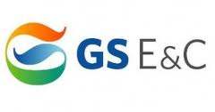



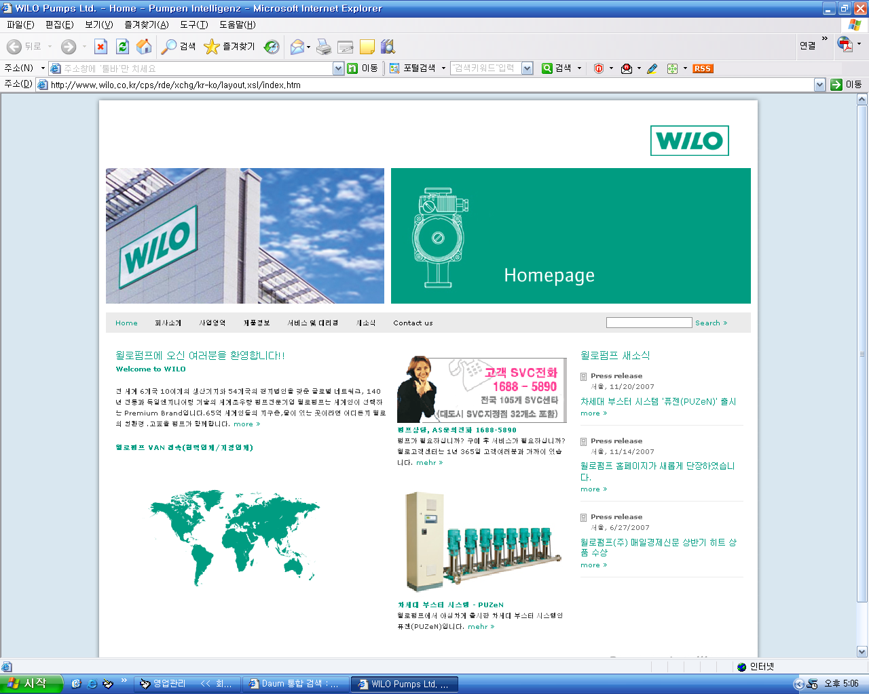











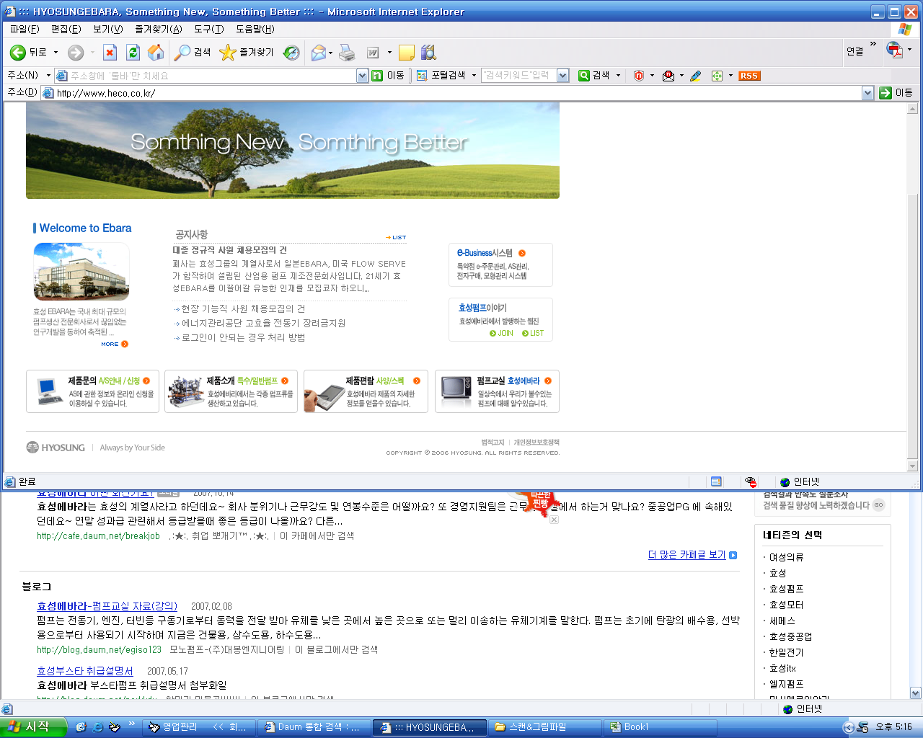


















주요 고객사 - Korea
EPC
Power Plant
Shipyard
General Plant
Pump
Airport

Slide 16



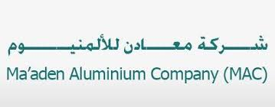












주요 고객사 - Overseas

Slide 17
Topics
제품
장비
회사 소개
주요 실적
품질

Slide 18
품질 관리 정책
Slogan
고객을 만족시키기는 어렵지만 고객의 요청은 항상 옳다
Target of Quality Control
고객사의 불만족 률 : 0.03% 이하
모든 제품 검사
Policy of Quality Control
기본부터…
Customer’s dissatisfaction feedback
Products record management
Active A/Service and continuous service
Trouble rate 0.03%

Slide 19
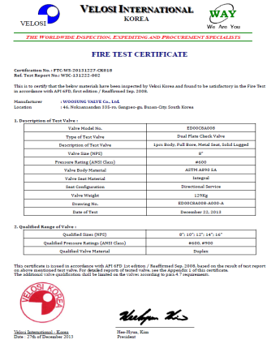
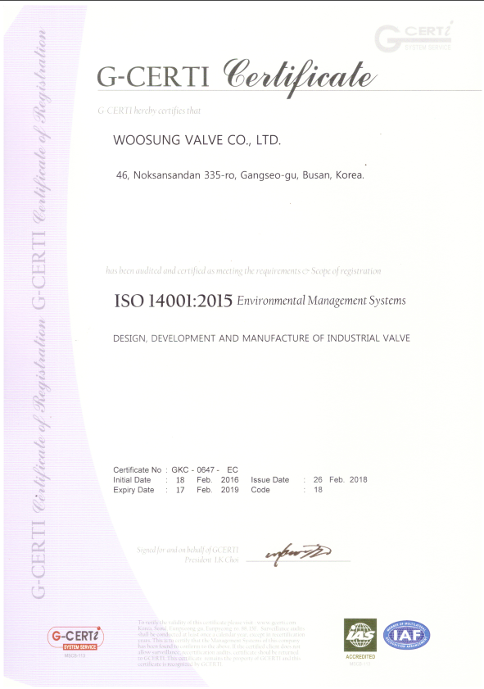
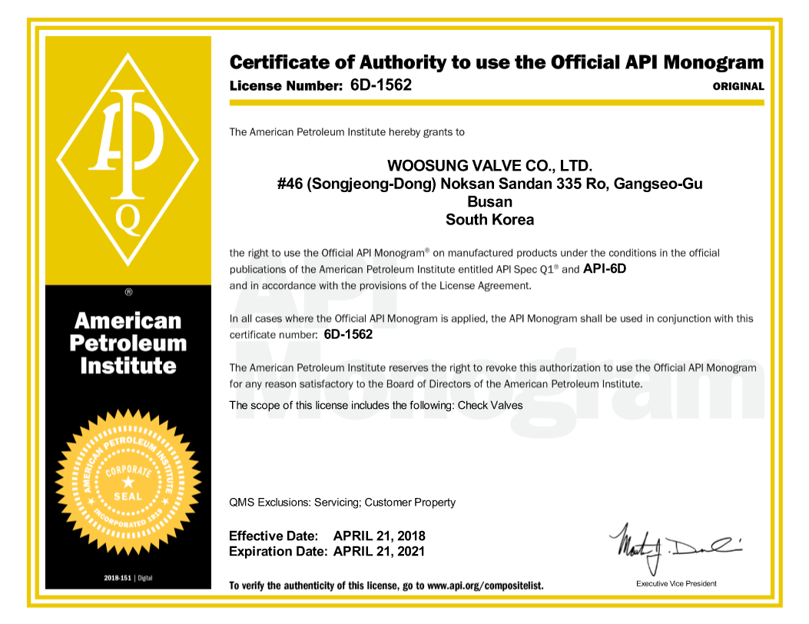
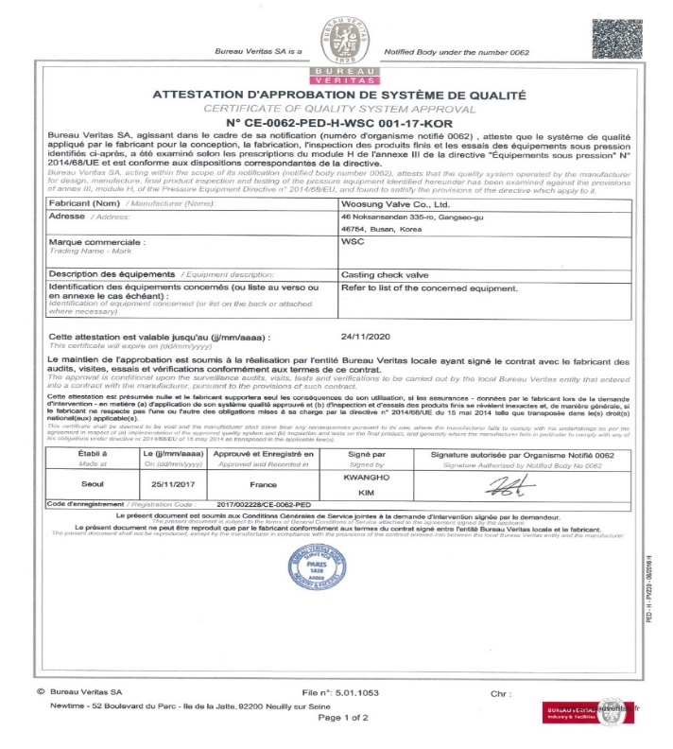
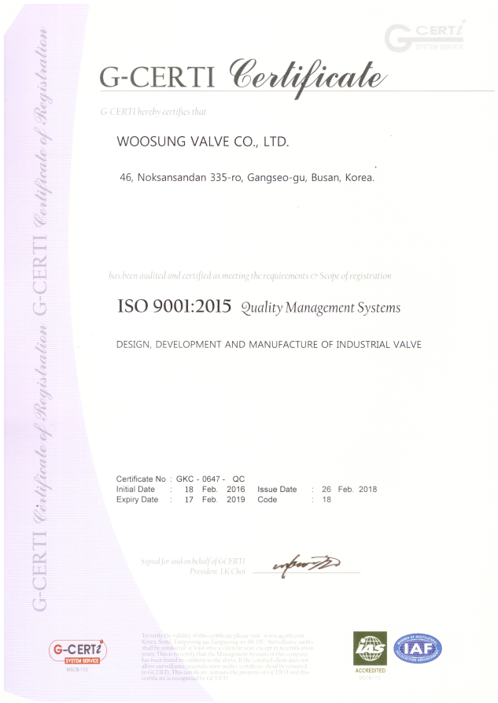
인증서
Fire Safety Certificate
ISO 14001 Certificate
API 6D Certificate
ISO 9001 Certificate
BV Certificate

Slide 20
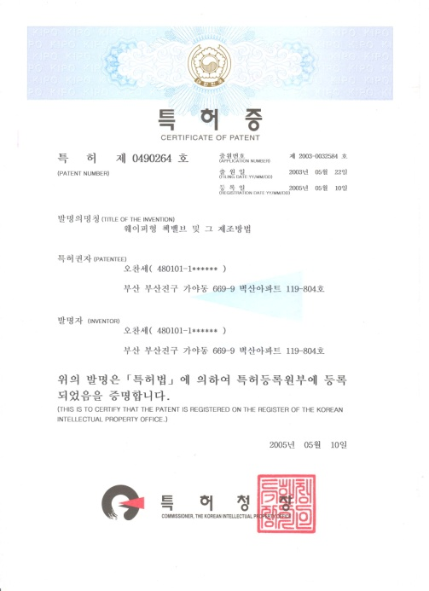
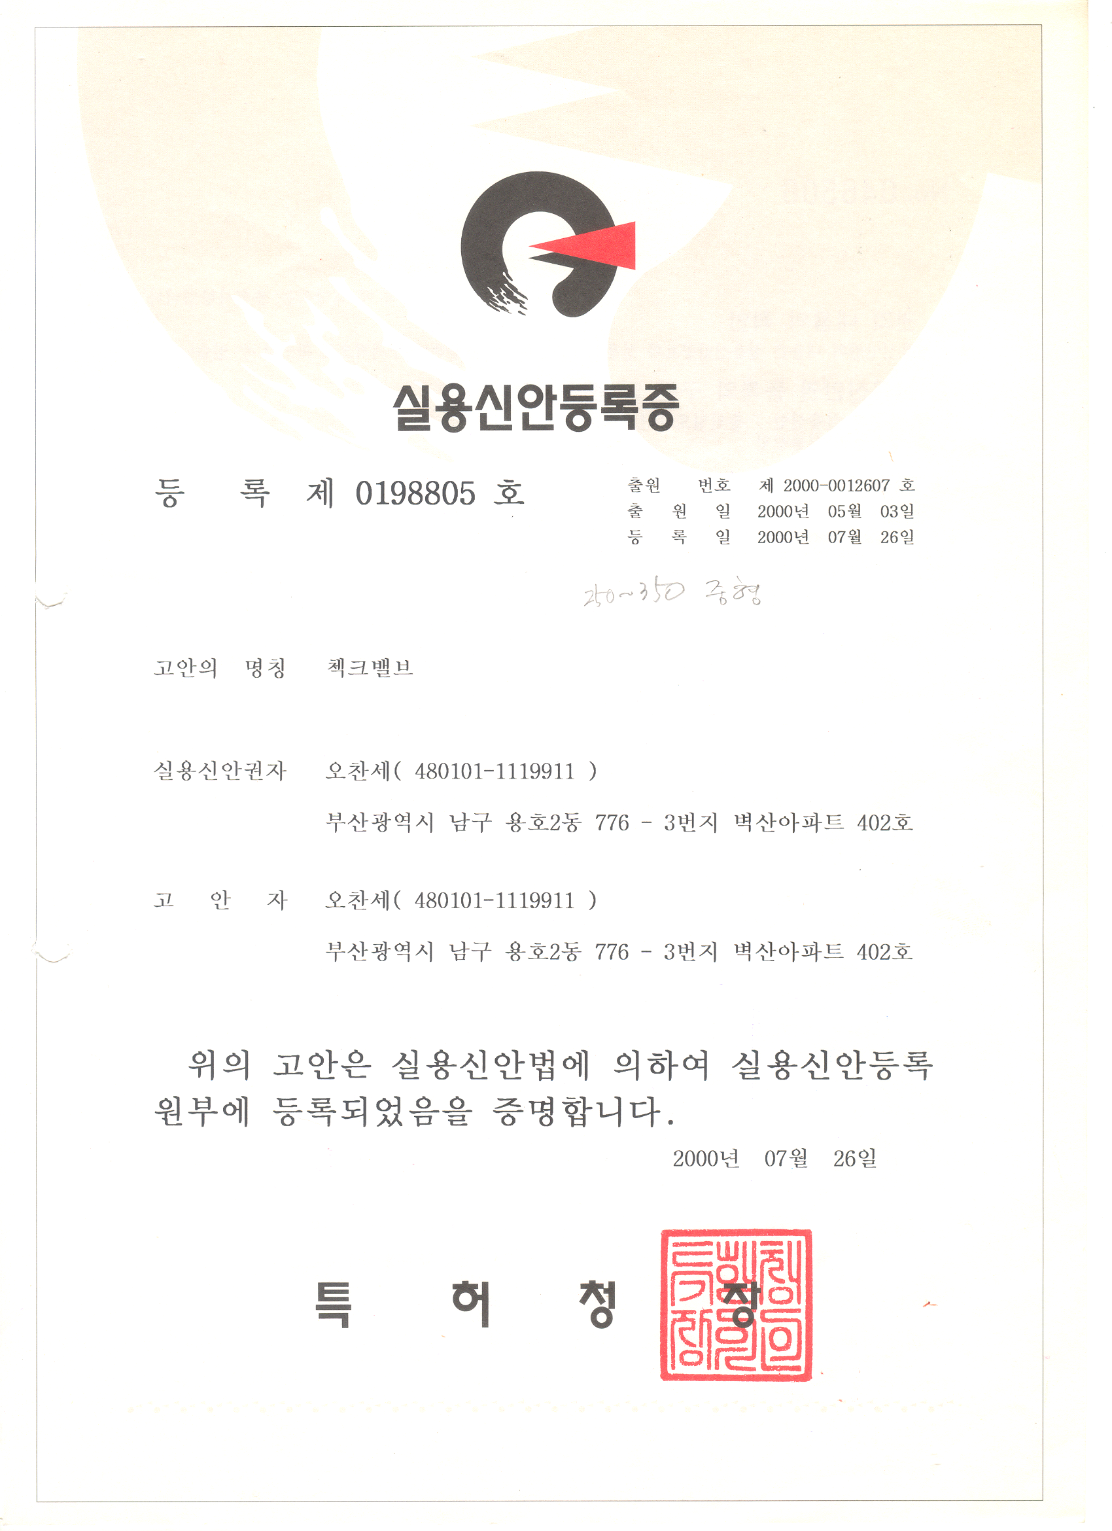
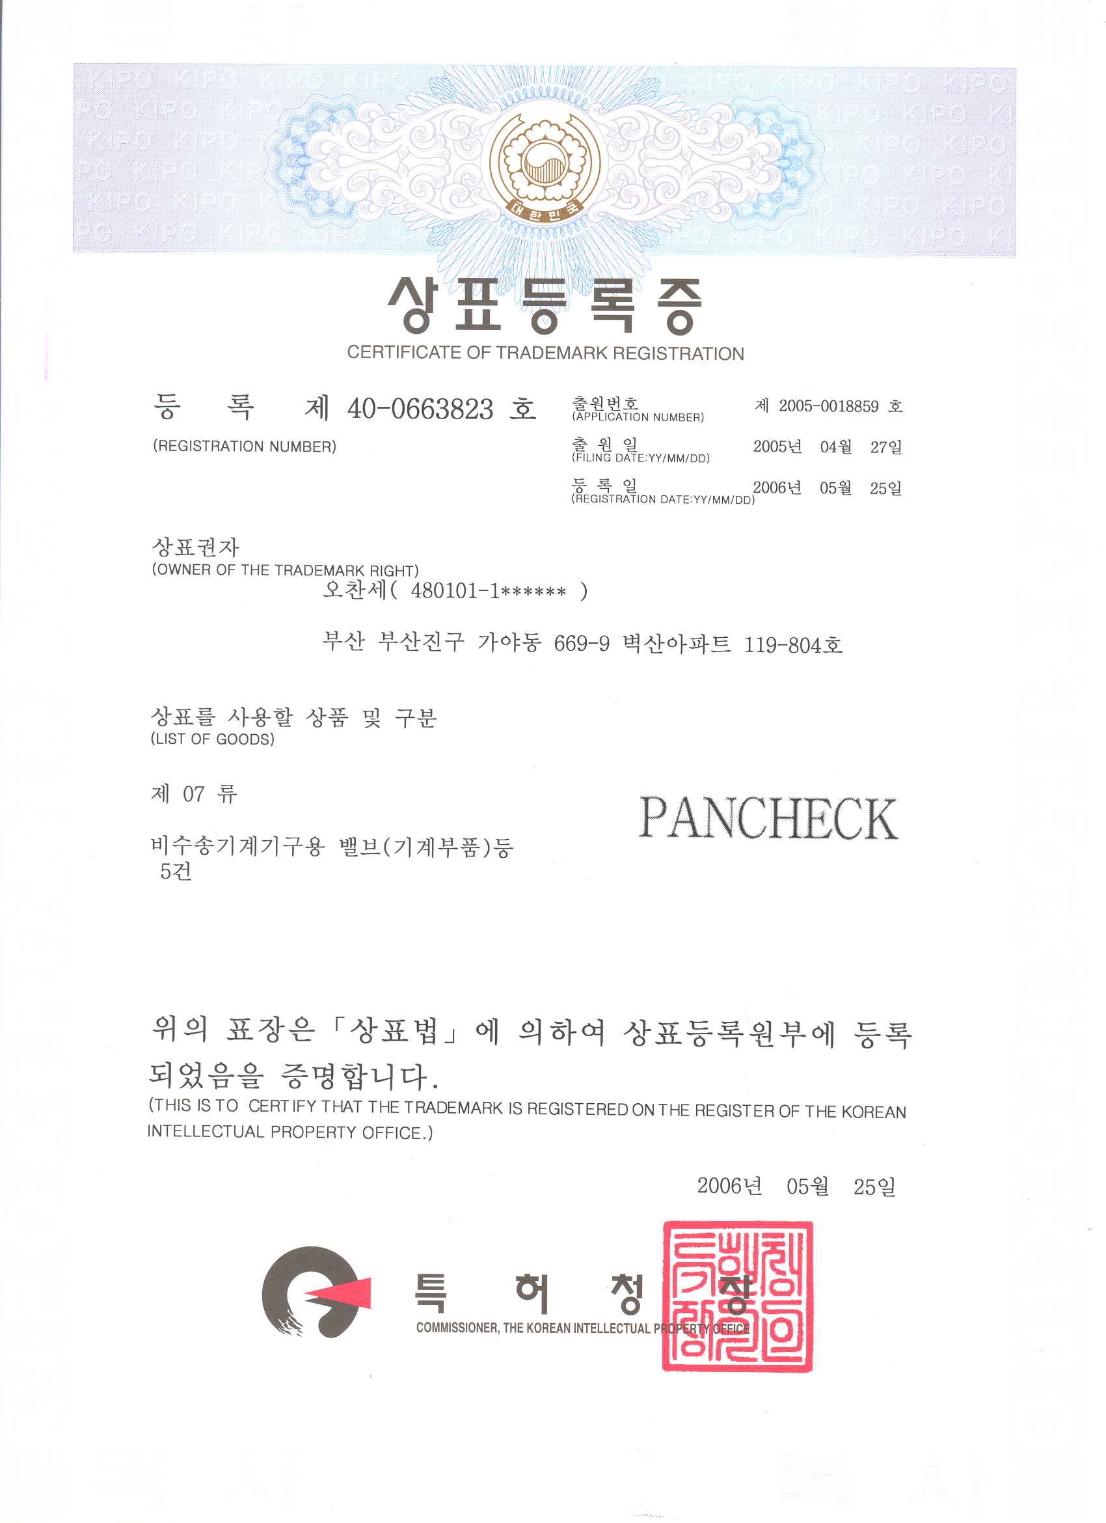
인증서 및 특허현황
Certificate of Patent
Certificate of Trademark
Patent on a new device

Slide 21
Topics
장비
회사 소개
공급 실적
품질
제품

Slide 22
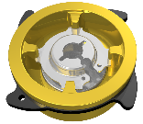
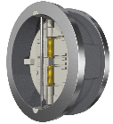
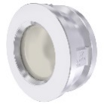
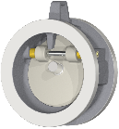
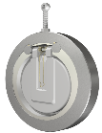
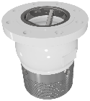
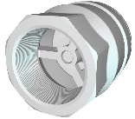
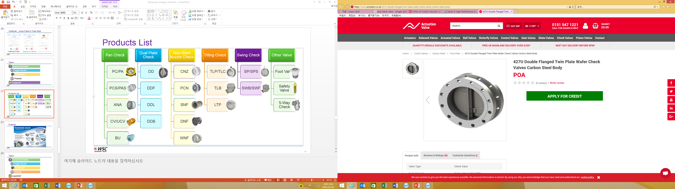
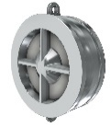
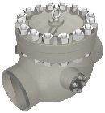
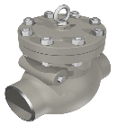

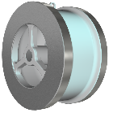
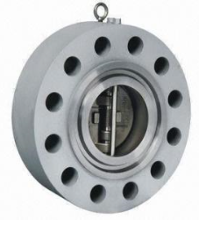
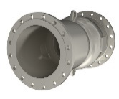
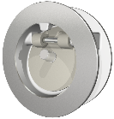
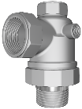
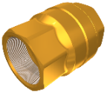
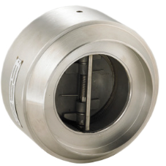
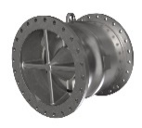
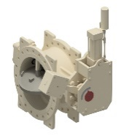
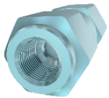
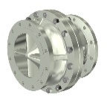
제품 List
Non-Slam Nozzle Check
CNZ
PCN
Tilting Check
TLP/TLC
TLB
SNF
DNF
WNF
LTP
Swing Check
SP/SPS
SWB/SWF
Other Valve
Foot
Valve
Pan Check
PC/PA
PCS/PAS
ANA
CV/UCV
BU
Dual Plate Check
DD
Safety Valve
5-Way Check
DDB
DDL
DDF
NBCF
Non-Slam Nozzle Check
CNZ
PCN
Tilting Check
TLP/TLC
TLB
SNF
DNF
WNF
LTP
Swing Check
SP/SPS
SWB/SWF
Other Valve
Pan Check
PC/PA
PCS/PAS
ANA
CV/UCV
BU
Dual Plate Check
DD
Safety Valve
5-Way Check
NBCF
Floating Check

Slide 23
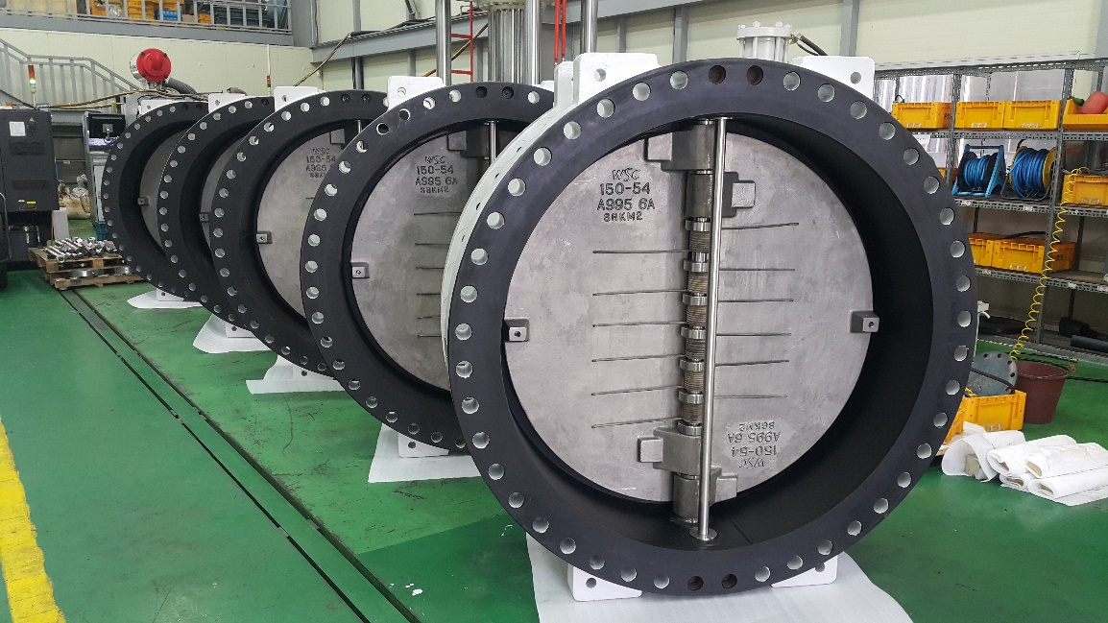
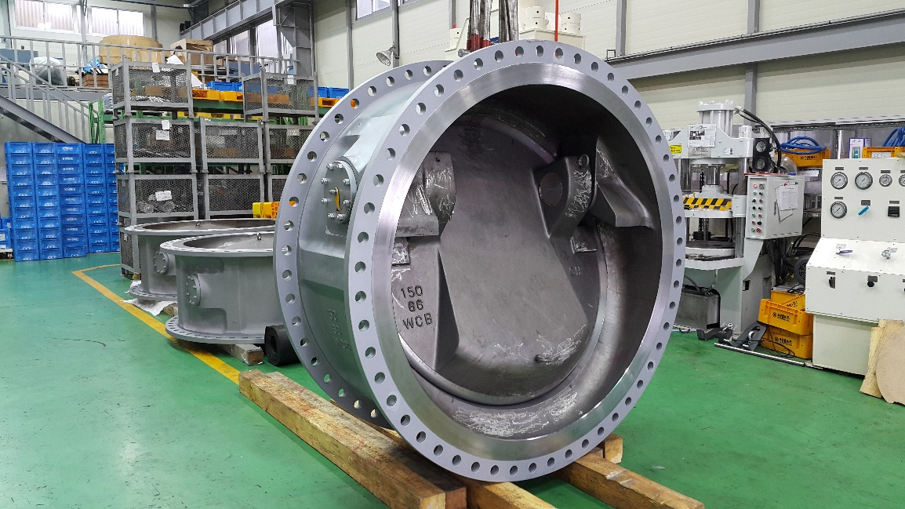
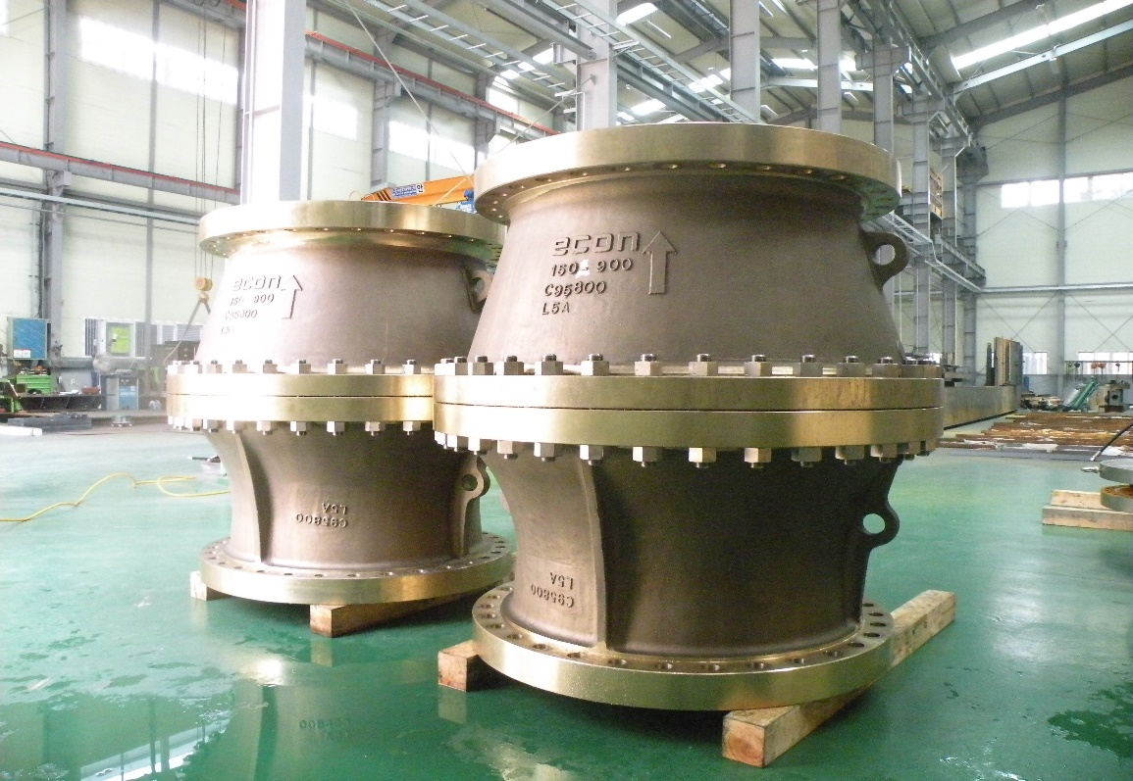
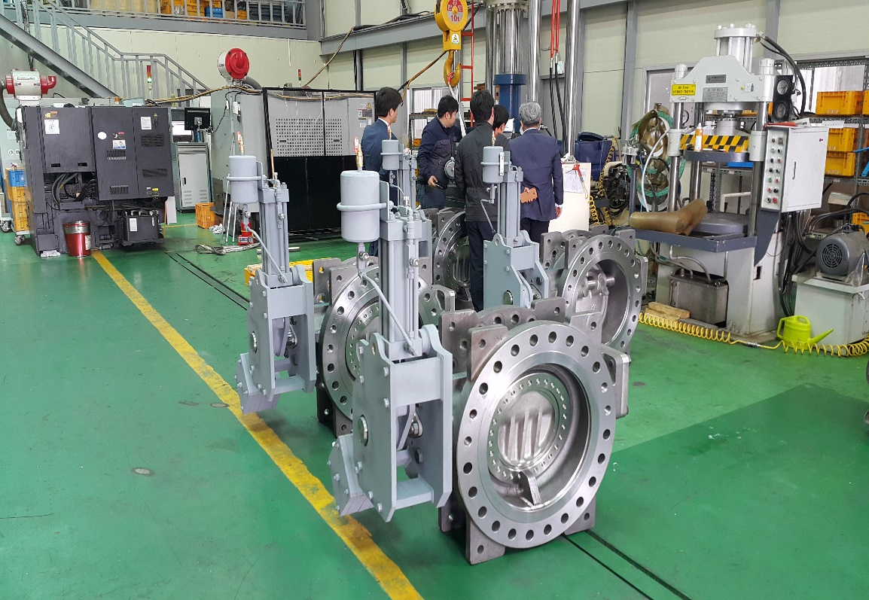
제품 주요 사전

Slide 24
Topics
회사 소개
공급 실적
품질
제품
장비

Slide 25
장비 현황
MCT
Maker – Doosan
Installed Year – 2019
CNC Turing Center
Maker – Doosan
LATHE
Maker - Namseon
Installed Year – 2008
Q`ty – 2EA
Installed Year – 2007
Q`ty – 1EA
Q`ty – 2EA
Milling Machine
Maker - Hwacheon
Installed Year – 2012
Q`ty – 1EA
Radial Ball Machine
Maker - Changjo
Installed Year – 2007
Q`ty – 2EA
UP Drilling
Maker – Jokwang
Installed Year – 2009
Lapping
Maker – Cleantech
Polishing
Maker - Kumyeong
Installed Year – 2003
Q`ty – 3EA
Installed Year – 2008
Q`ty – 2EA
Q`ty – 1EA
Tig & ARC & Spot Welder
Maker - Woojin & Jinseong
Installed Year – 2000 & 2005
Q`ty – 3EA
Screw Compressor
Maker - KAESER
Installed Year – 2010
Q`ty – 2EA

Slide 26
장비 현황
500 Ton Hydraulic Pressure
Maker – Cleantech
Installed Year – 2013
80 Ton Hydraulic Pressure
20 Ton Hydraulic Pressure
Maker - Howon
Installed Year – 1999
Q`ty – 1EA
Q`ty – 1EA
Air Pressure Tester
Maker - Piatech
Installed Year – 2014
Q`ty – 1EA
Valve Tester
Maker - Intech
Installed Year – 2003
Q`ty – 1EA
Q`ty – 1EA
Installed Year – 2006
Maker – Cleantech
Safety Valve Tester
Maker – Deaha
Installed Year – 2013
Cryogenic Tester
Maker – Deaha
Sand blasting
Maker - World
Installed Year – 2018
Q`ty – 3EA
Installed Year – 2018
Q`ty – 2EA
Q`ty – 1EA
Ultrasonic wave cleaner
Maker - Shinha
Installed Year – 2003
Q`ty – 1EA
3-Way Valve Tester
Maker - Cleantech
Installed Year – 2007
Q`ty – 1EA

Slide 27
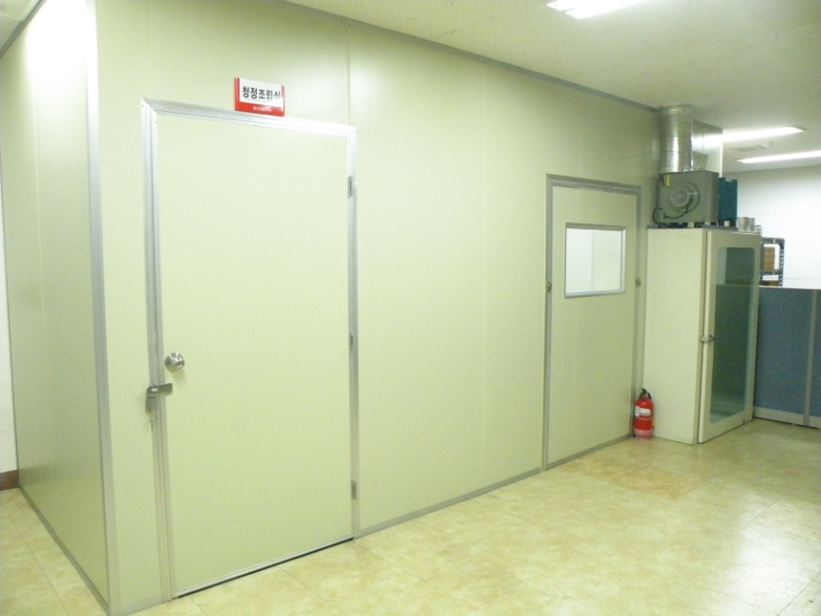
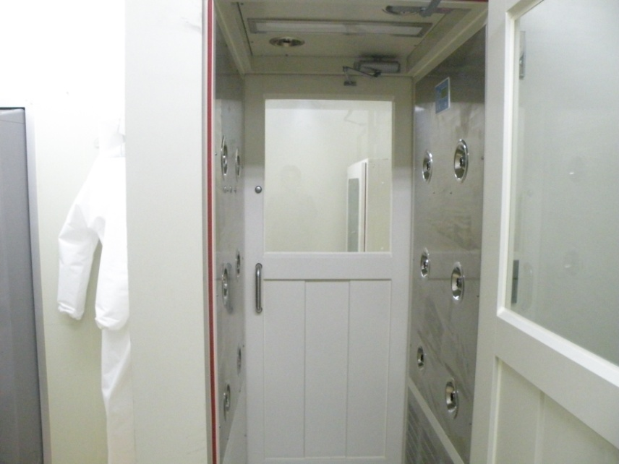
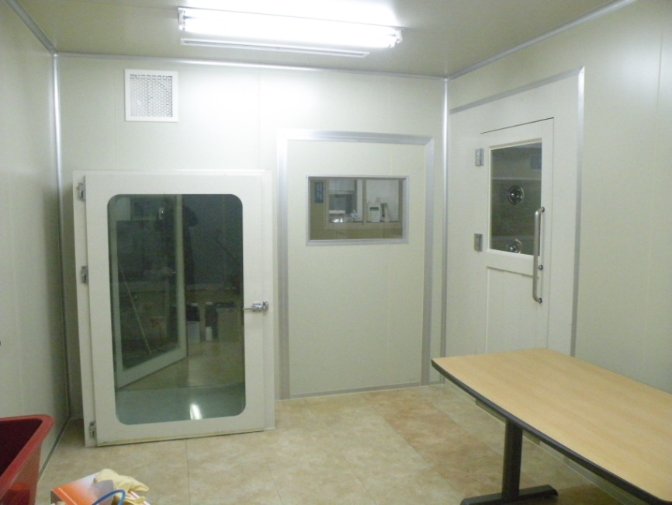
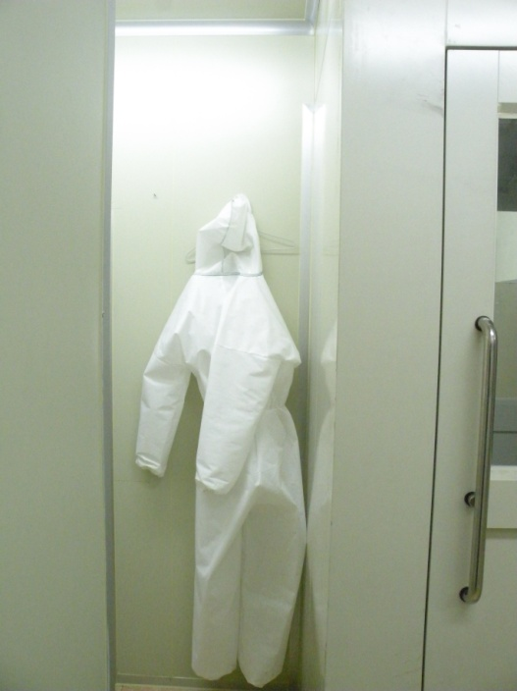
Clean Room

Slide 28
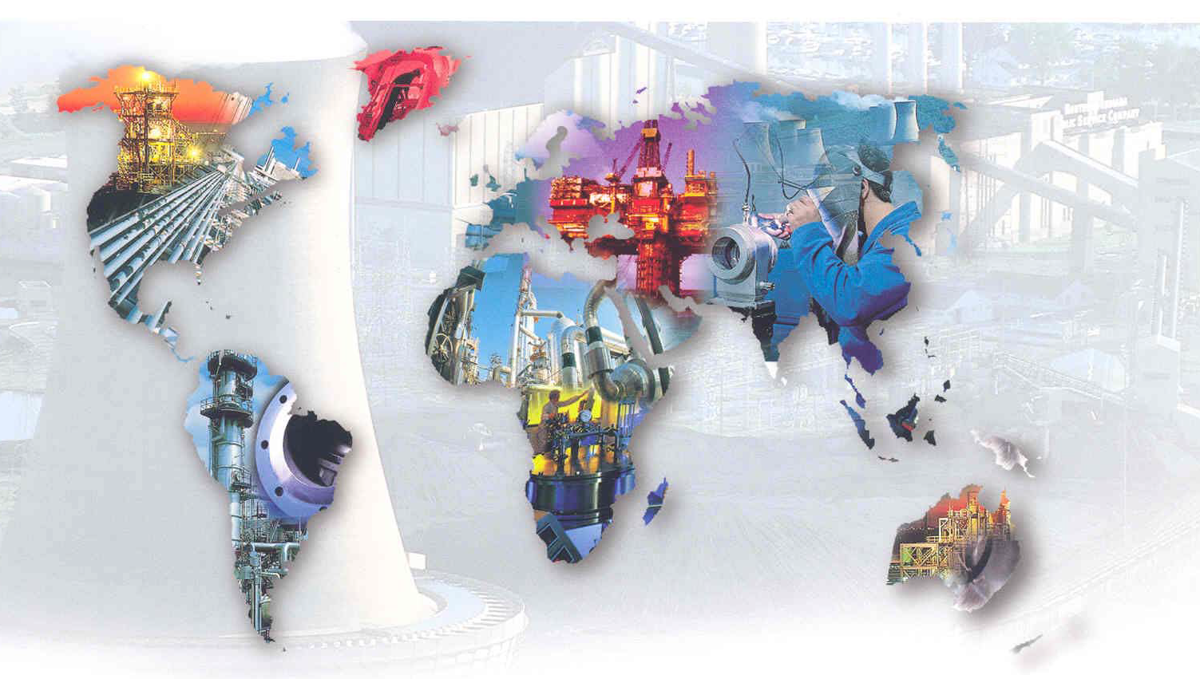
질문
THANK YOU
ALWAYS BE WITH YOU

